Slide 1
Introduction
Forests give a few biologically, monetarily and social point of view capacities to life viz., water supplies, soil preservation, supplement cycling, species and ozone harming substances guideline. Expanding anthropogenic pressing factors, for example, land use/land cover changes, air, water and soil contamination, debasement of soil quality and misfortunes in organic variety are some significant dangers to profitability of biological systems at provincial and worldwide scales. Current situation shows that farming practices have been a significant factor for land change in this world. A lot of this rural land has been made to the detriment of regular woodlands, fields and wetlands that give important living spaces to species and administrations for humanity. Today, around half of the initial forests have disappeared. As the pace of living space and species annihilation keep on rising, the requirement for preserving the natural variety turned out to be progressively basic during the most recent years. It is a troublesome errand to gain such data based on field evaluation and observing. Forest cover changes at local to worldwide scales requires a methodology dependent on distant detecting.

Slide 2
OBJECTIVES
Objective 1: Classifying features on map using supervised learning in QGIS
Objective 2: Detecting Deforestation and Afforestation in Madhya Pradesh
Objective 3:Change Detection between January,2016 - January 2021
Objective 4: Publishing in web application

Slide 3
RELATED BACKGROUND
Remote sensing provides a systematic, synoptic view of earth cover at regular time intervals and useful for changes in land cover and to reveal aspects of biological diversity directly. Satellite image classification, change analysis and econometric modelling are extensively used to identify the rates and drivers of deforestation in global hotspots of biodiversity and tropical ecosystems..

Slide 4
TOOLS AND TECHNOLOGY
Data from USGS
QGIS
R Programming
Geoserver
OpenLayers
Extjs
PostGIS

Slide 5
MODULES AND EQUIVALENT DATA SOURCES
Change Detection
Afforestation-
Deforestation
Object Classification
Location | Date
Near Bhopal | January 2016,February 2017,February 2018,February 2019,February 2020 and January 2021
Location | Date
Near Bhopal | January 2016 and January 2021
Location | Date | Operations
Ahmedabad | 10-9-20 | Band Combination
Near Ahmedabad (For land and river) | 16-1-21 | Supervised Classification

Slide 6
IMPLEMENTATION DETAILS

Slide 7
Object Classification
Download the data of desired location and time within the Landsat tile footprint from earthexplorer.
Extract and browse to the directory in qgis, import the bands in layers.
In Semi-automatic classification plugin or SDP, import all the layers in band set-1 and go to pre-processing. Then clip the section of tile which is to be analyzed and classified.
Remove the previous layers but keep only the clipped ones.
In SDP, Re-import the layers in band set-1 (remove previous layers), select the satellite to Landsat-8 in dropdown list [It will adjust the wavelengths accordingly].
Now, go to the preprocessing tab and browse to Landsat, tick correction in volumetric clouds and specify clipped layers folder and .Mtl file for the data [included in extracted landsat data].
Click run and remove previous layers. Keep only with [RT_] named layers.
In the RGB panel, specify the bands combination in order to transform the layers according to wavelengths and requirements.
Now, SDP panel and under training input select add, click on polygon and select the features on map like river, vegetation, buildings. [Hold ctrl for selecting more than 1 polygon]. Specify the class for each feature and click on add selected polygon to training input.
Now click on view classified tile and tap on map to view classified features.

Slide 8
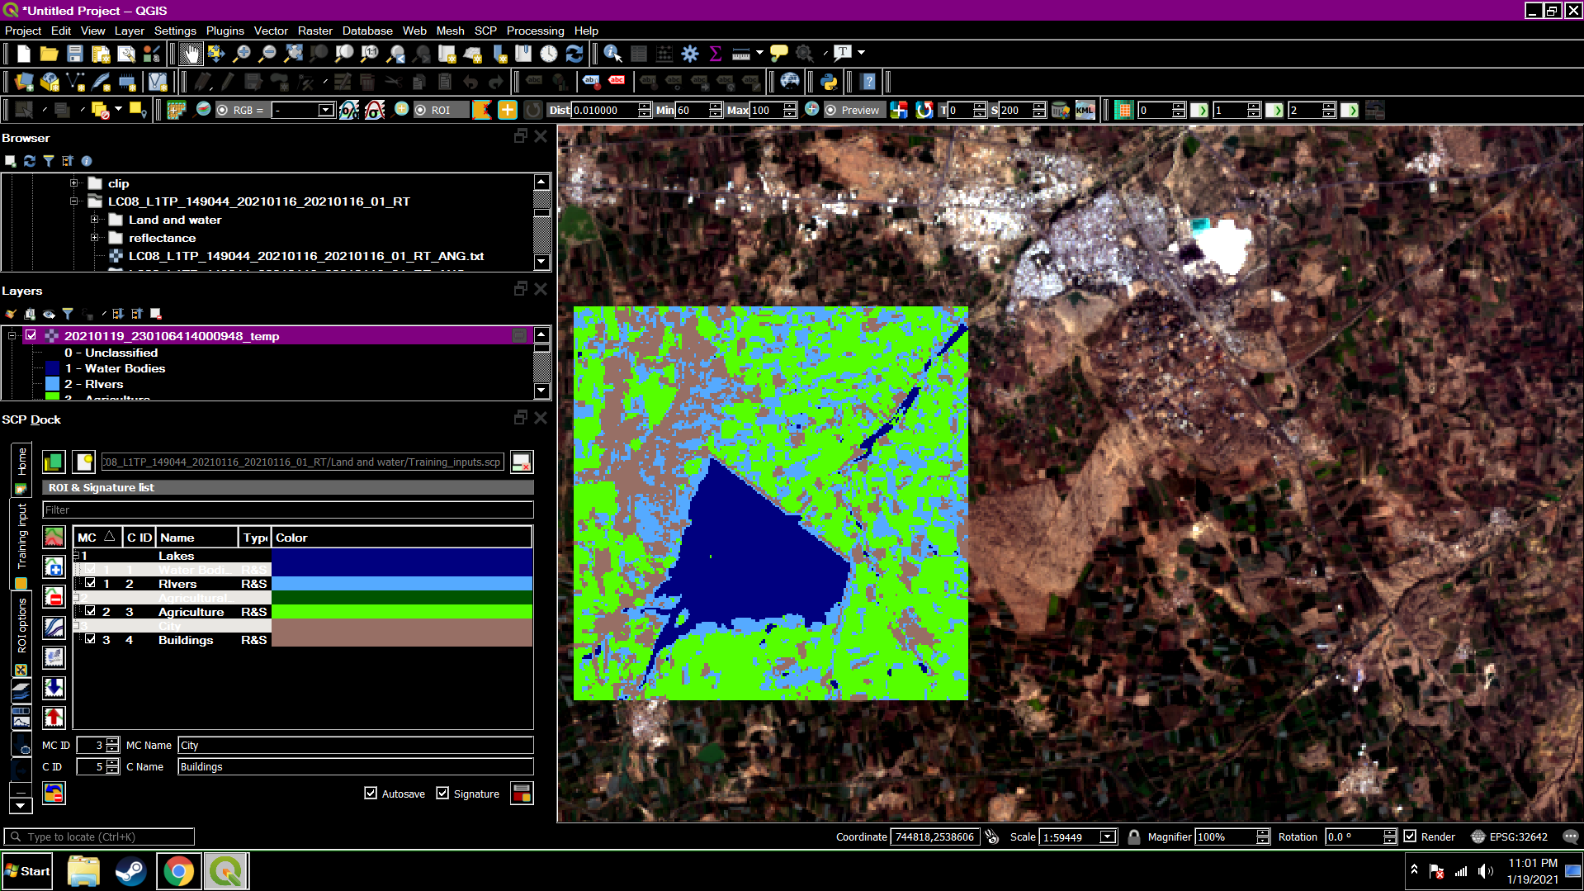
Output (scp Plugin)

Slide 9
Detecting Afforestation and Deforestation
1.Acquire Data
2. Import Band images in Qgis
3.Make composite layer for band combinations (8-4-3 for vegetation)
4. Clip the desired area from both the images (2016 and 2021) and merge them. To verify the result, I took NDVI difference of both year images.
5. Create a shapefile for training input
6. Load training shapefile and merged image into R for Random forest classification
7. Style the output image.

Slide 10
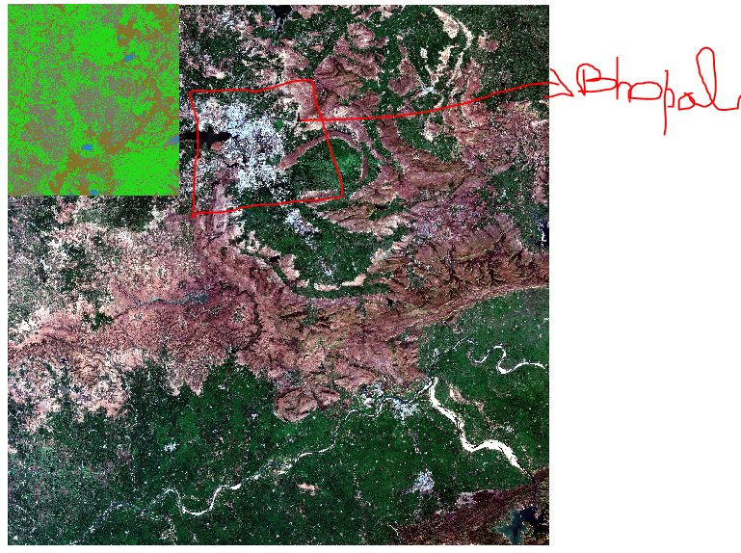
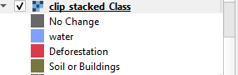
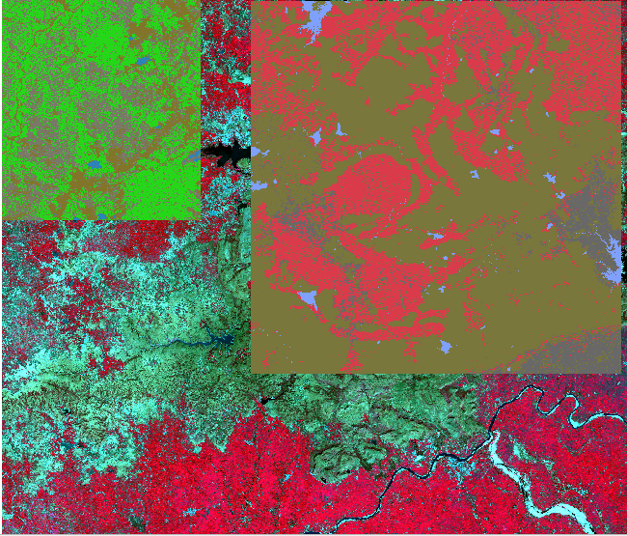
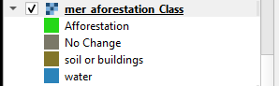

Slide 11
Change Detection
1.Acquire Data
2. Import Band images in Qgis
3.Make composite layer for band combinations (8-4-3 for vegetation)
4. Clip the desired area from all the images (Jan-2016,Feb-2017,Feb-18,Feb-19,Feb-20 and Jan-2021) and merge them. To verify the result, I took NDVI difference of images.
5. Create a shapefile for training input
6. Load training shapefile and merged image into R for Random forest classification
7. Style the output image.

Slide 12
Results

Slide 13
Publishing
Vectorize raster images in QGIS.
Publish them in geoserver.
Create a web application page using extjs,openlayer,html.

Slide 14
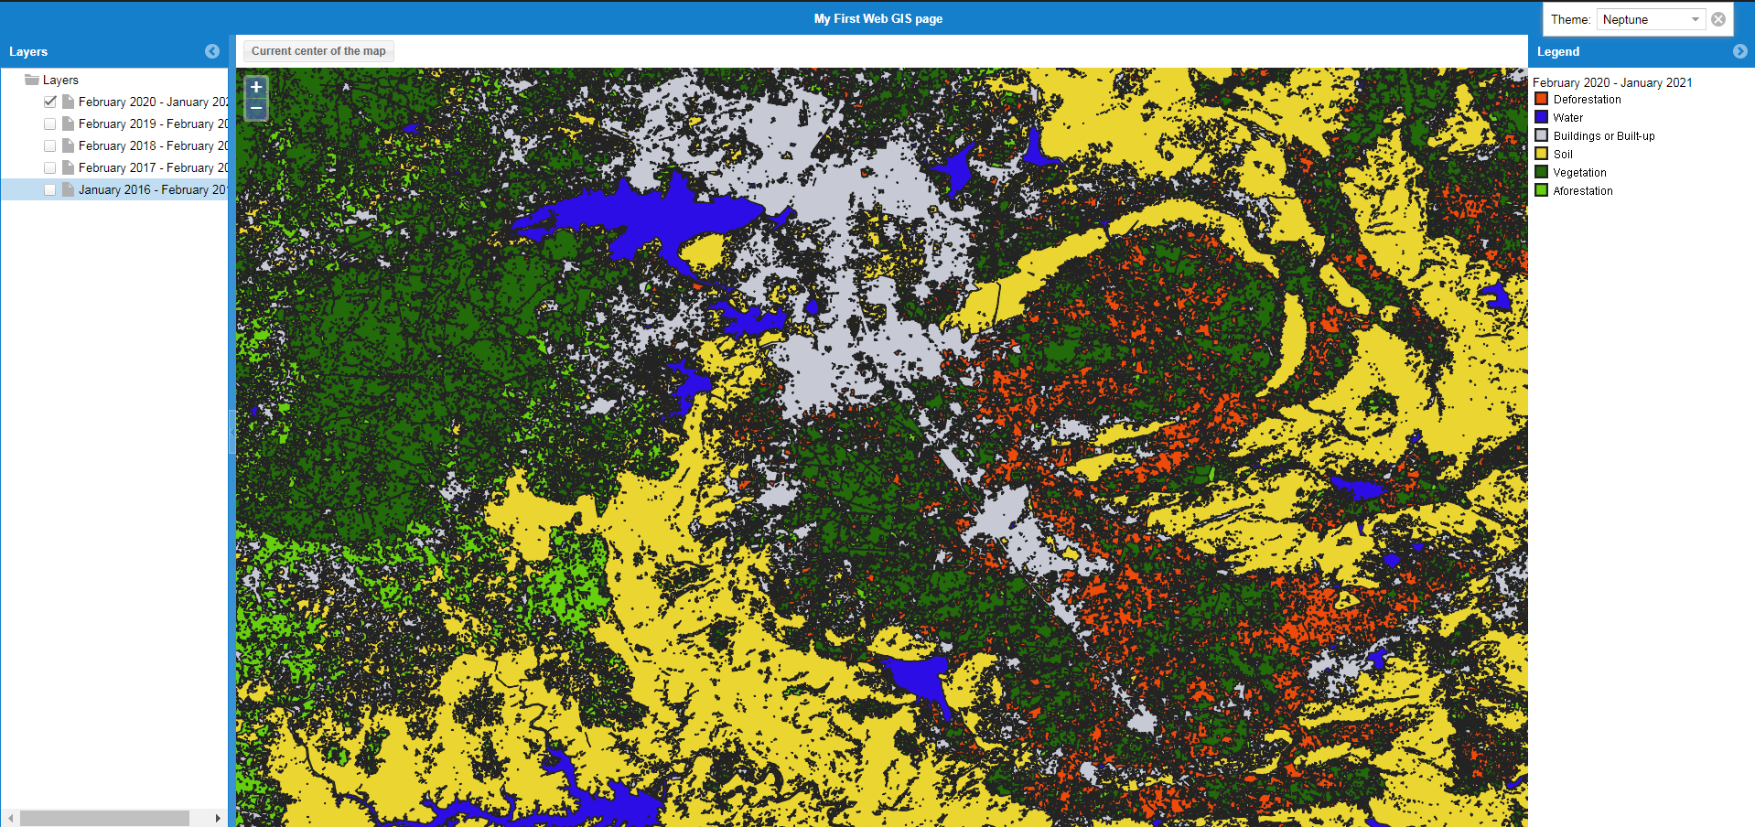
Output of Web Application

Slide 15
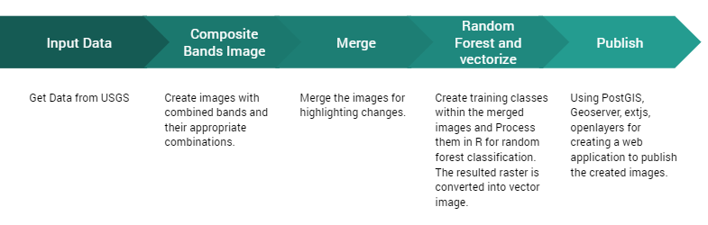
Summary Process Model

Slide 16
CONCLUSION
Afforestation is essential and a must for all humans to take that in serious consideration. The Visualization reflects that urbanization is leading to loss of forests. Policies for development can be drafted on comparing the forested and deforested extent.

Slide 17
FUTURE WORK
Exploring remote sensing domain further and expanding our knowledge on the same, we will be looking into exploring machine learning with remote sensing whilst performing geo spatial tasks on various areas using geo pandas and visualize the same using folium library and python code. Further we will work on qgis to implement a tasks such as mangroves mapping, and vegetation quantification, etc.

Slide 18
References
1) Multi Spectral Imagery
https://www.youtube.com/watch?v=j61X3l6LvxY&ab_channel=KlasKarlsson
2) Land Cover Classification using the Semi-Automatic Classification
https://www.youtube.com/watch?v=Ceyhm3DlZNY&ab_channel=LucaCongedo
3) USGS
https://earthexplorer.usgs.gov/
4) Vegetation and Bio-mass Estimation using QGIS
https://youtu.be/Odm8A1myBaI
5) Nasa Arset change detection
https://www.youtube.com/watch?v=-IOiwRJPtlY&ab_channel=NASAVideo
6) Band Combinations
https://openweather.co.uk/blog/post/satellite-imagery-landsat-8-and-its-band-combinations
7) Open Layers
https://openlayers.org/

